Slide 1

BIRLA INSTITUTE OF TECHNOLOGY MESRA, RANCHI
DEPARTMENT OF ELECTRONICS AND COMMUNICATION ENGINEERING
Minor Project Presentation On
Cloud Removal In Satellite Images: An Image Processing Approach
PRESENTED BY:
Honey Pradhan (BTECH/10168/21)
Shreya Gupta (BTECH/10429/21)
Rishika Agrawal (BTECH/10508/21)
GUIDED BY:
Dr Prajna Parimita Dash

Slide 2
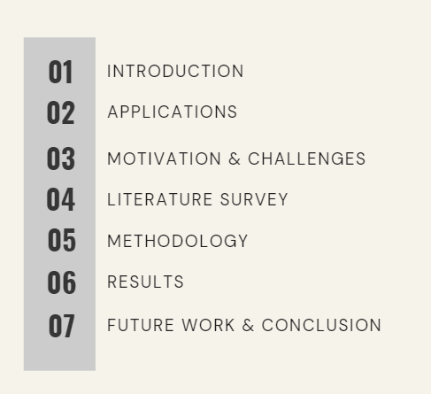
CONTENTS

Slide 3
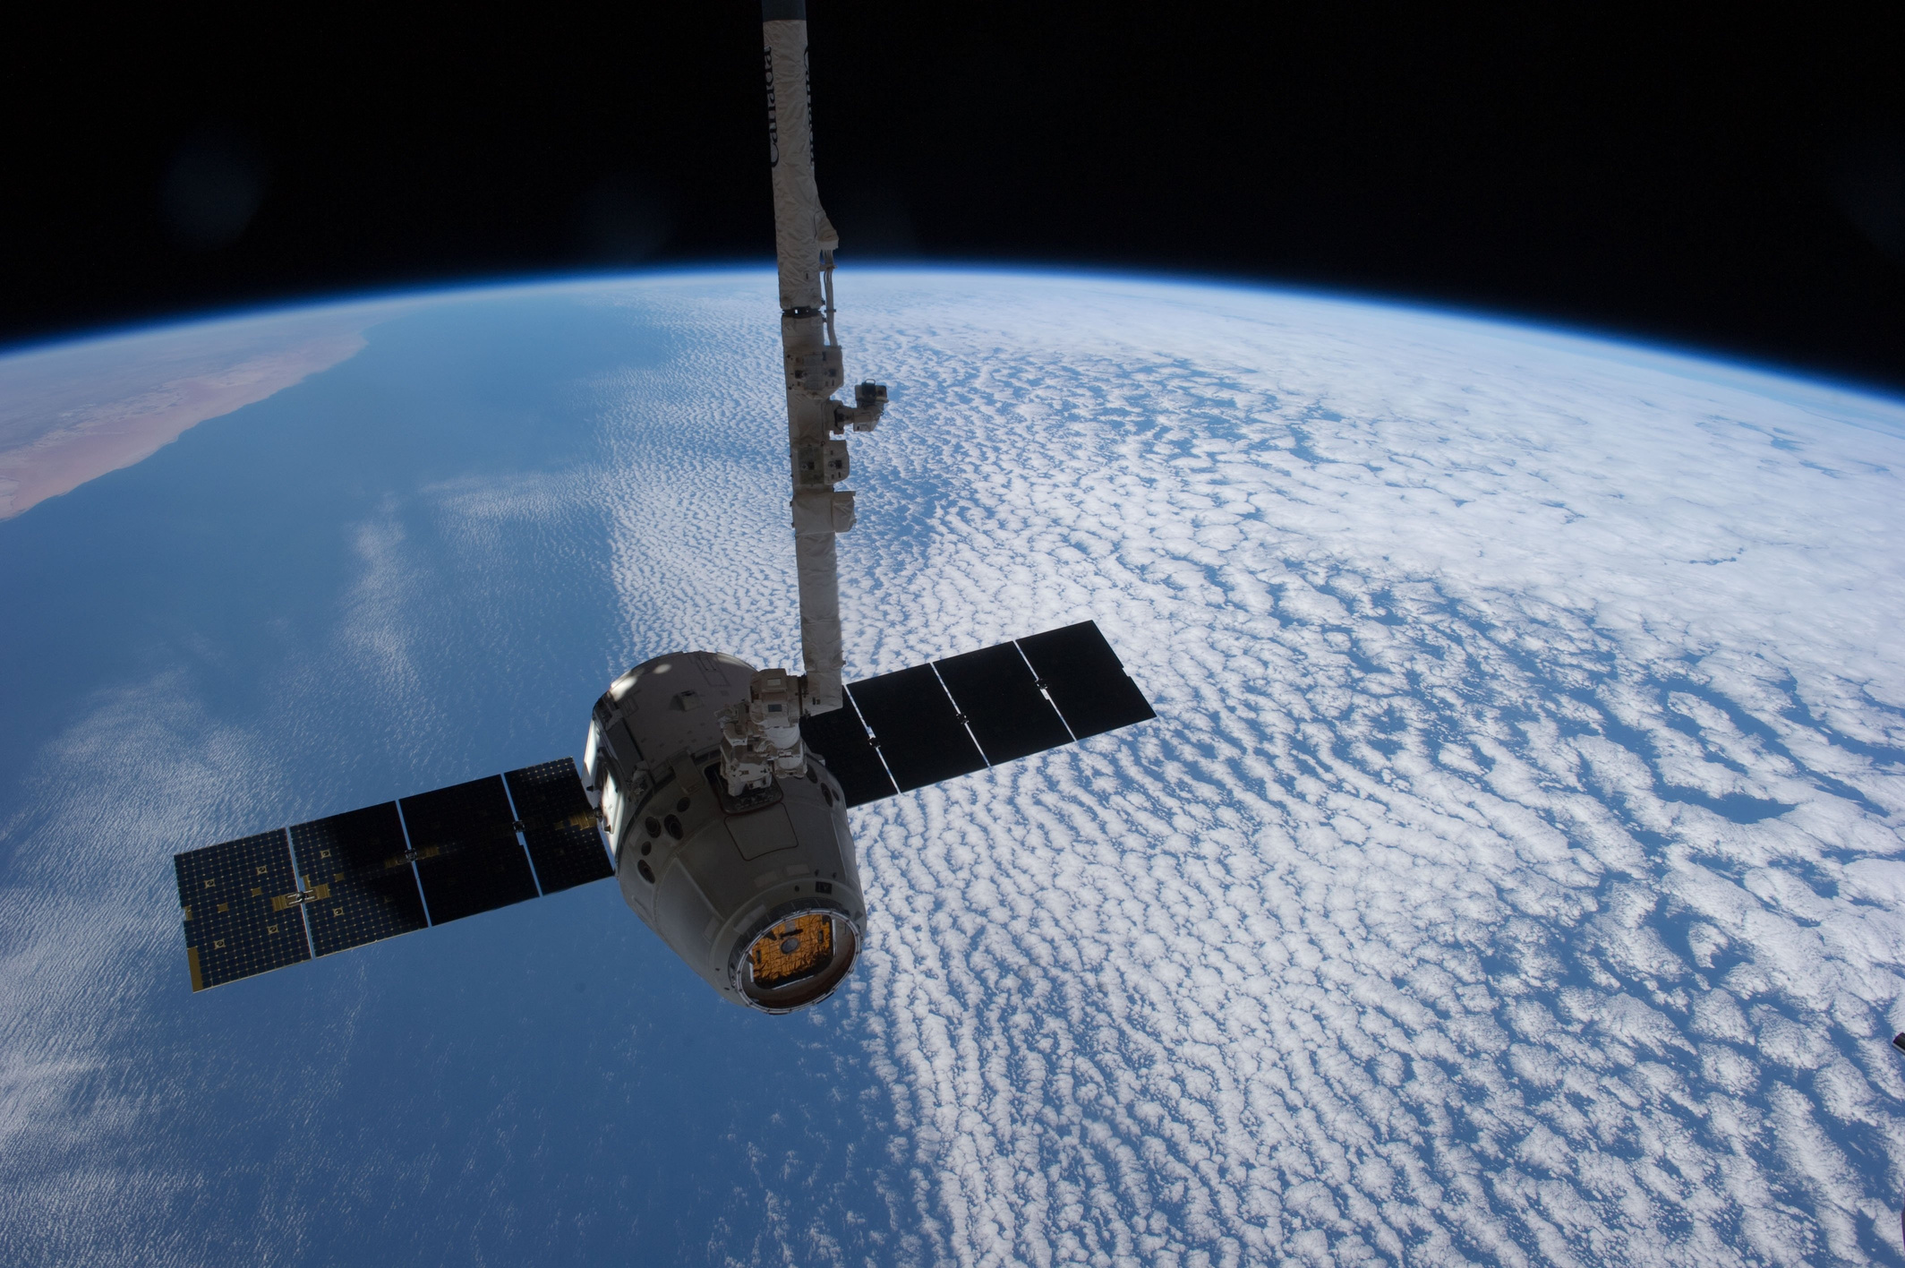
INTRODUCTION
1
• Satellite images help to monitor and analyze diverse aspects of the Earth's surface.
• Characteristics of Satellite images: Spatial Resolution, Spectral Resolution and Temporal Resolution.
•
• Presence of Cloud Cover creates a visual barrier, hampering the ability to obtain clear images.
•
• Landsat and Sentinel series satellites are the mainstream data sources.
•
• Landsats have visible and near-infrared (VNIR) bands and thermal infrared (TIR) bands.

Slide 4
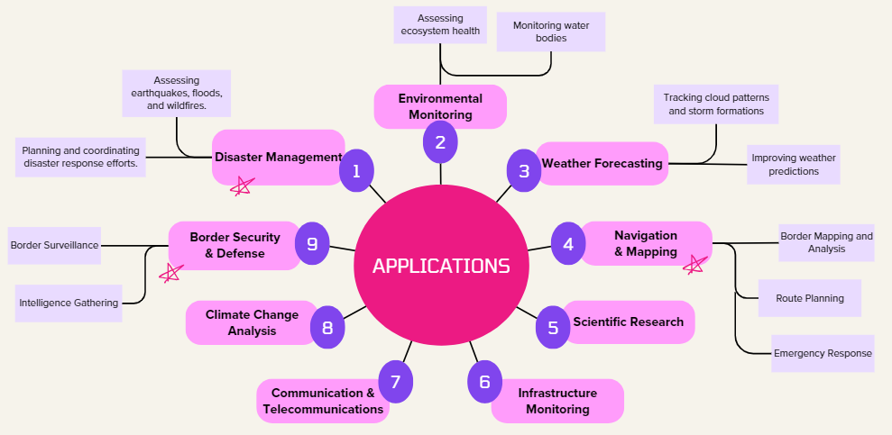
APPLICATIONS
2

Slide 5
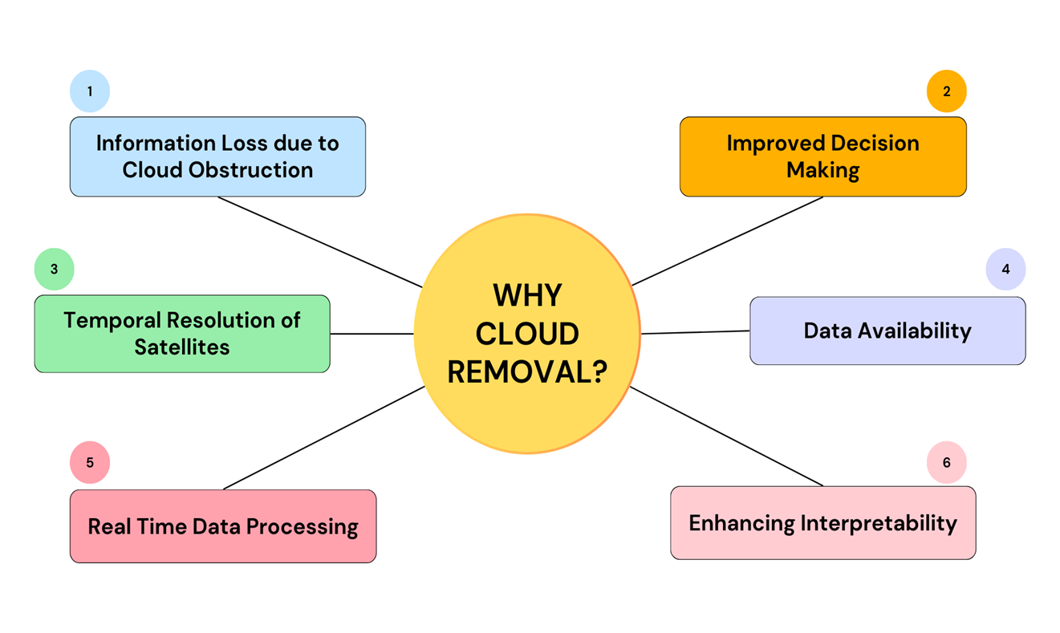
MOTIVATION
3

Slide 6
LITERATURE REVIEW
4
TITLE | AUTHORS | PROPOSED METHOD | DISCUSSION
A General Thin Cloud Correction Method Combining Statistical Information and a Scattering Model for Visible and Near-Infrared Satellite Images ^{[2]} | Chi Zhang, Huifang Li, Huanfeng Shen, Huagui He , Yang Liu, Peng Yi, and Liying Xu | Cloud correction method for satellite VNIR images By coupling statistical information with a scattering model to solve the problem. | Effectively produces cloud-free images with credible color, outperforming traditional and deep learning methods in quantitative measures. Includes versatile cloud mapping using a thin cloud map (TCM) and addresses the parallax problem in satellite data.
Cloud removal in remote sensing images using nonnegative matrix factorization and error correction ^{[1]} | Xinghua Li, Liyuan Wang , Qing Cheng, Penghai Wu, Wenxia Gan, and Lina Fang | Introduces a Non-negative matrix factorization (NMF) and error correction method (S-NMF-EC) for cloud removal in optical remote sensing images. | Aims to retain the maximum cloud-free information of the cloud-contaminated image. Error correction is applied to improve the cloud removal result by considering land-cover types and reconstruction errors.
Training-free thick cloud removal for Sentinel-2 imagery using value propagation interpolation^{[3]} | Laurens Arp, Holger Hoos , Peter van Bodegom, Alistair Francis, James Wheeler, Dean van Laar, Mitra Baratchi | The VPint2 method leverages spatial interpolation with cloud-free reference images to effectively reconstruct cloudy regions in remote sensing data without requiring prior training. | Outperforms traditional and neural network-based methods, achieving up to 34.3% improvement in structural similarity and mean absolute error metrics.

Slide 7
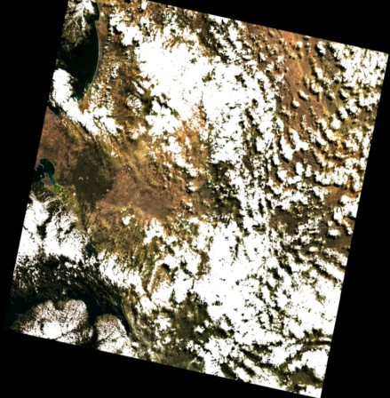
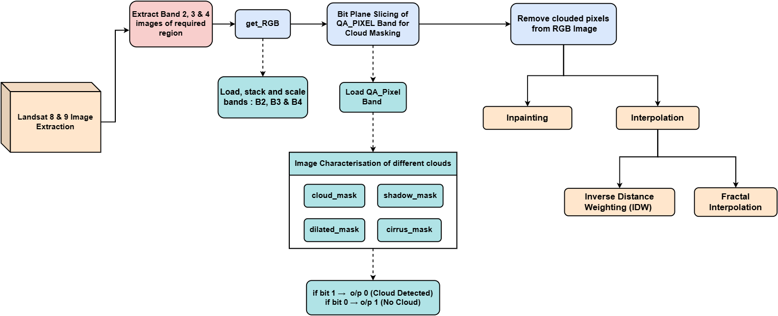
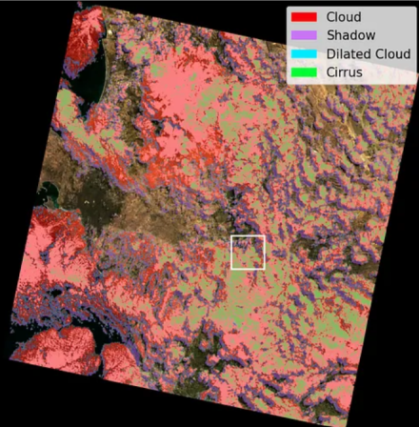
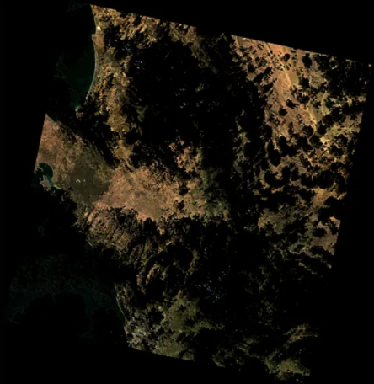
METHODOLOGY
5
Original cloudy Image
Cloud-masked Image
Cloud-removed Image

Slide 8
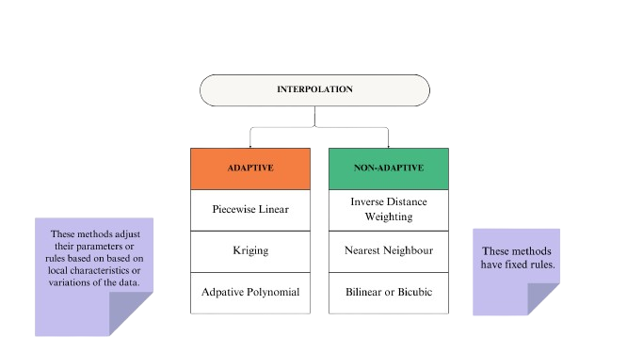
INTERPOLATION
6
Interpolation
A type of estimation method used for constructing (or finding) new data points
Based on the range of a discrete set of known data points
IDW
Weighted average of multiple neighbors
Deterministic and Computationally Efficient
Simple and intuitive method
Requires no complex mathematical calculations
FRACTAL
Adaptive Interpolation method
Uses Self-Similar Structures
Involves Repeated Iterations
Includes complex Interpretation patterns
Notes:
Kriging is a family of interpolation methods that use weighted averages of known data points to estimate unknown values. The weights are determined based on the spatial configuration and covariance structure of the data, taking into account both the distance and the direction between points. The key idea behind Kriging is that points closer together in space are more likely to have similar values, a concept known as spatial autocorrelation

Slide 9
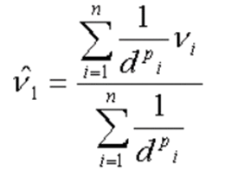
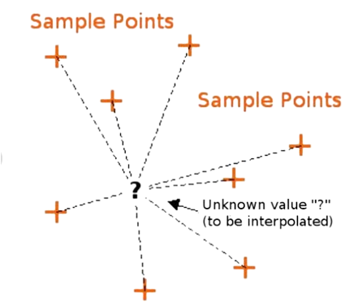
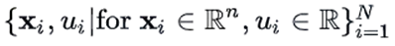
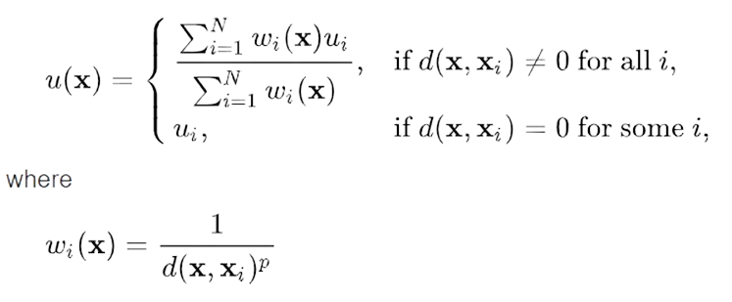
INVERSE DISTANCE WEIGHTING INTERPOLATION
7
The general formula for IDW interpolation is given by:
where, v_{i} : known value at the i-th cloud-free pixel, d_{i} : euclidean distance from the known point, p : constant that controls the weight (typically p = 2), n : total number of points used in interpolation (n = 5, here)
​​​ For a set of sample points,
where, u(x) : IDW Interpolation Function,
w_{i}(x) : IDW weighting function, x : denotes an interpolated point, x_{i} : an interpolating point, d : distance from the known point x_{i} to the unknown point x, N : total number of points used in interpolation.

Slide 10
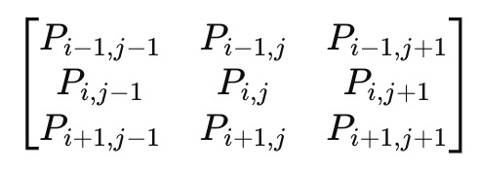
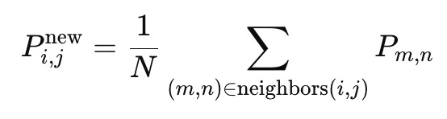
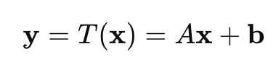
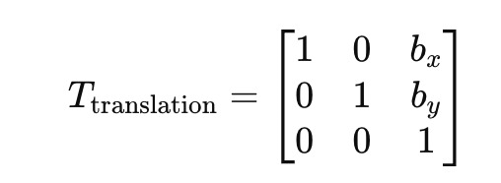
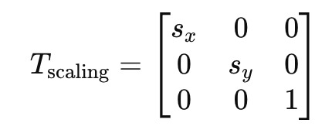
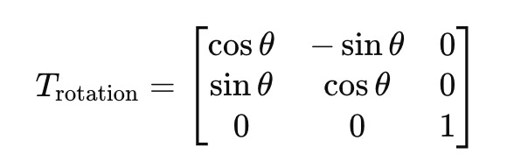
FRACTAL INTERPOLATION
8
Fractal Interpolation using Averaging Neighborhoods: Taking a 3x3 neighbourbood of a pixel at location (i,j), it’s neigborhood pixels are represented in the form of a square grid as follows:
where, P(i,j) : represents intensity of pixel at (i,j)
For a given pixel, 𝑃_{i,j} , intensity at the unknown data point after averaging its neighboring pixels is:
Fractal Interpolation using Affine Transformation: An affine transformation, T, in two-dimension can be written as:
Translation: Transformation Matrix for translation is given as:
b. Scaling: Transformation Matrix for scaling is given as:
c. Rotation: Transformation Matrix for rotation is given as:

Slide 11
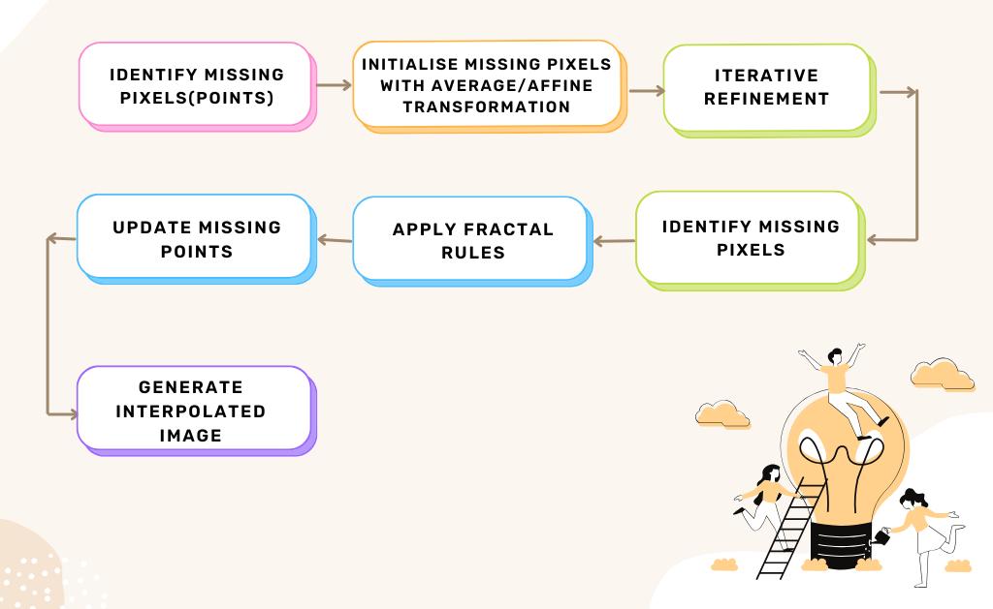
FRACTAL INTERPOLATION
9

Slide 12
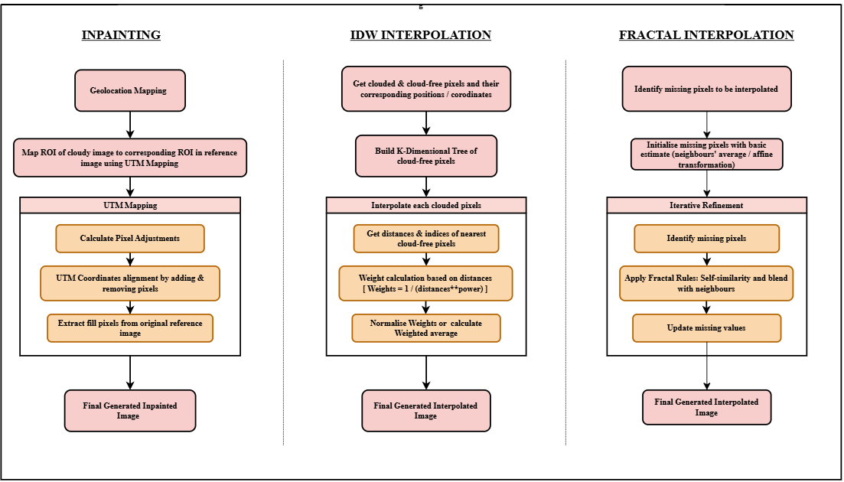
INPAINTING v/s INTERPOLATION
10

Slide 13
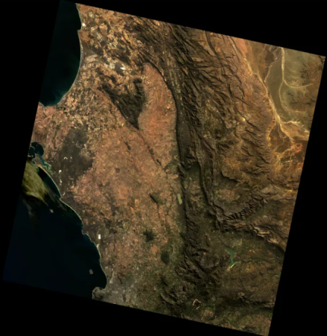
﻿RESULTS: INPAINITNG
11
a) Original Cloudy RGB Image [ Cloud Coverage: 61.79% ]
b) Original Clear Image
c) Cloud Mask with four cover types
Limitation
Original Cloudless Satellite
Image Required
d) Cloud removed RGB Image
e) Generated Inpainted Image [Cloud Coverage: 1.87%]

Slide 14
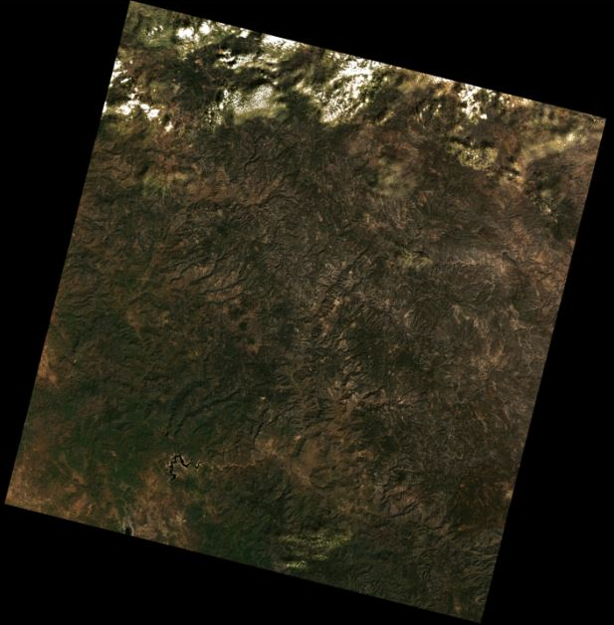
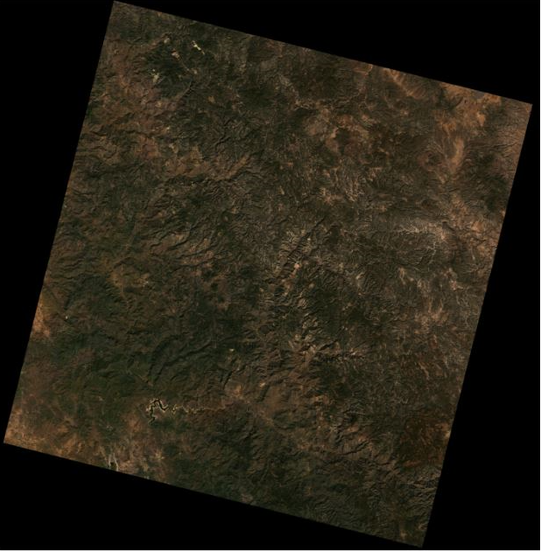
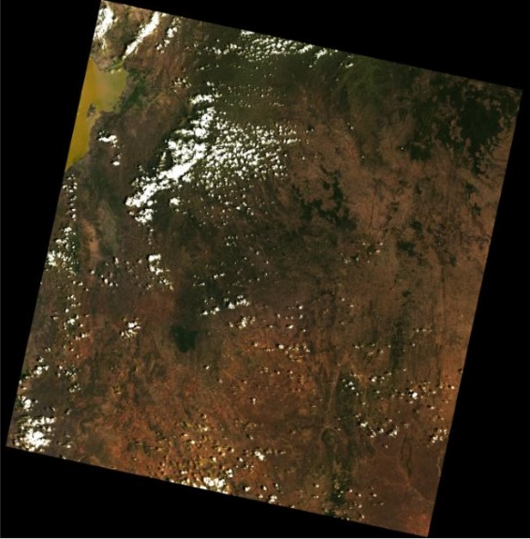
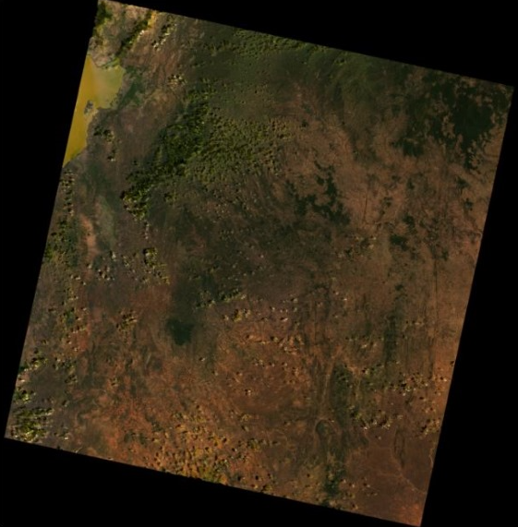
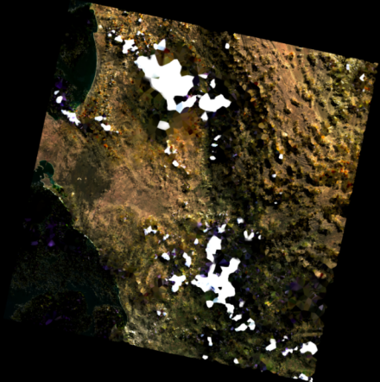
﻿RESULTS: IDW
12
Original Cloudy Image
Generated Interpolated Image
Satellite Name : Landsat 8 Collection 2 Level 2
Satellite Spatial Resolution : 30 meters
Scene Center Latitude : 27.43142
Scene Center Longitude : -107.86034
Date Acquired : 2024/10/10
Final Interpolated Image Generation Time : 1 hour
Cloud Coverage in Interpolated Image : 0.95 %
(a)
(a)
Satellite Name : Landsat 8 Collection 2 Level 2
Satellite Spatial Resolution : 30 meters
Scene Center Latitude : 5.78498
Scene Center Longitude : 38.60222
Date Acquired : 2024/03/02
Final Interpolated Image Generation Time : 2 hours
Cloud Coverage in Interpolated Image : 2.54 %
(b)
(b)
Satellite Name : Landsat 9 Collection 2 Level 2
Satellite Spatial Resolution : 30 meters
Scene Center Latitude : -33.17708
Scene Center Longitude : 18.91530
Date Acquired : 2023/04/10
Final Interpolated Image Generation Time : 5 hours
Cloud Coverage in Interpolated Image : 15.86 %
(c)
(c)

Slide 15
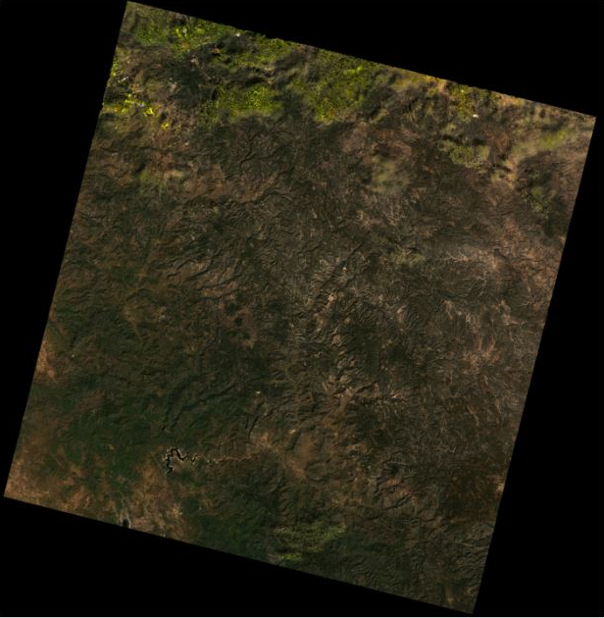
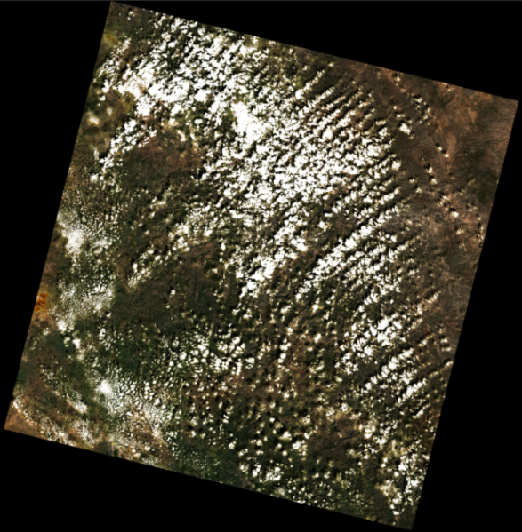
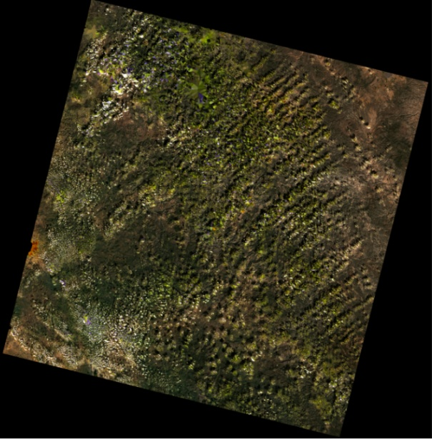
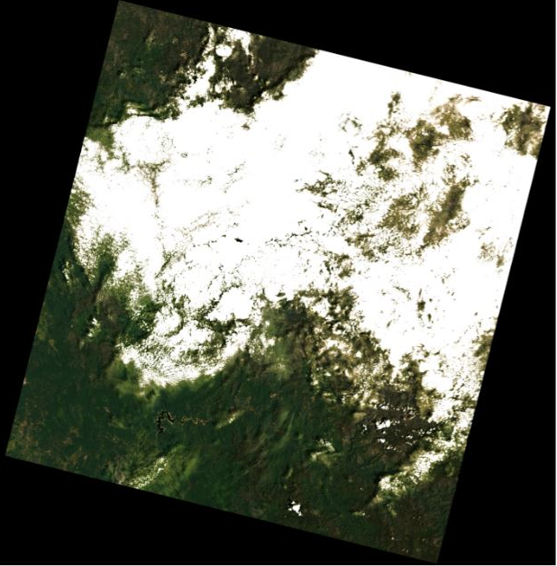
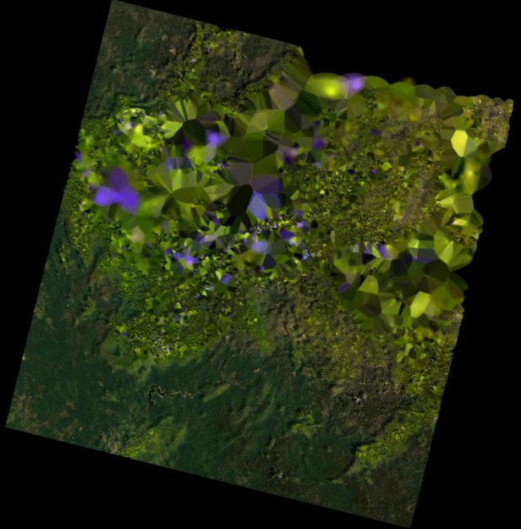
﻿RESULTS: FRACTAL
13
Original Cloudy Image
Generated Interpolated Image
Satellite Name : Landsat 8 Collection 2 Level 2
Satellite Spatial Resolution : 30 meters
Scene Center Latitude : 27.43142
Scene Center Longitude : -107.86034
Date Acquired : 2024/10/10
Final Interpolated Image Generation Time : 1.5 hours
Cloud Coverage in Interpolated Image : 1.08 %
(a)
(a)
Satellite Name : Landsat 9 Collection 2 Level 2
Satellite Spatial Resolution : 30 meters
Scene Center Latitude : 27.43126
Scene Center Longitude : -107.89565
Date Acquired : 2024/10/18
Final Interpolated Image Generation Time : 3 hours
Cloud Coverage in Interpolated Image : 5.26%
(b)
(b)
Satellite Name : Landsat 9 Collection 2 Level 2
Satellite Spatial Resolution : 30 meters
Scene Center Latitude : 27.43152
Scene Center Longitude : -107.87881
Date Acquired : 2024/08/31
Final Interpolated Image Generation Time : 5 hours
Cloud Coverage in Interpolated Image : 12.37 %
(c)
(c)

Slide 16
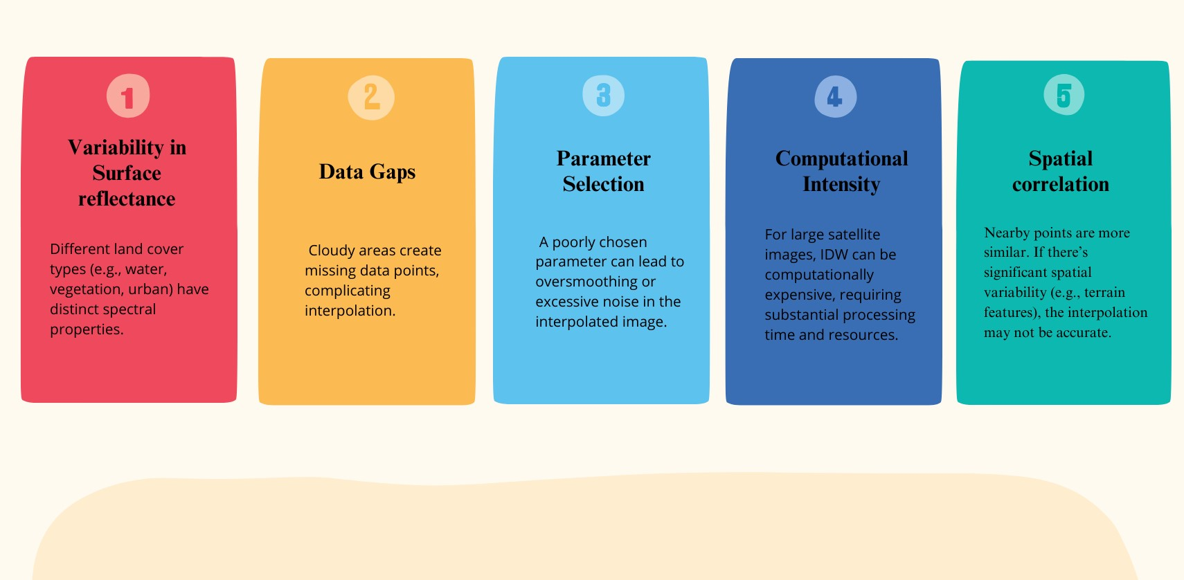
CHALLENGES
14

Slide 17
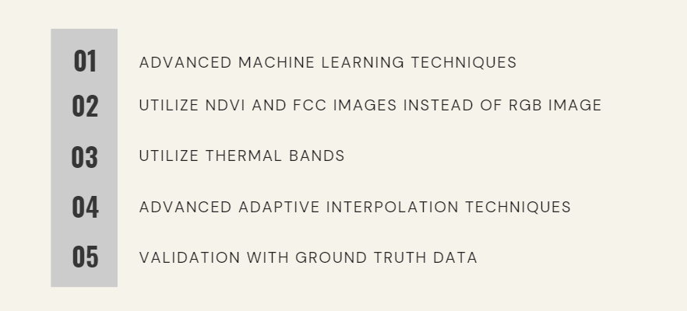
FUTURE WORK
15

Slide 18
CONCLUSION
16
The project successfully implements a cloud removal technique leveraging precise cloud detection, geolocation mapping, inpainting and interpolation strategies.
The use of Inverse Distance Weighting (IDW) and Fractal Interpolation interpolation effectively reconstructs cloud-affected regions by considering spatial relationships between known data points.
The proposed algorithms are extensively verified on multiple datasets.
The resulting images enhance clarity and usability, making them suitable for accurate analysis and various remote sensing applications.
Continued research and innovation are essential for maximizing the utility and reliability of satellite-based remote sensing technologies.

Slide 19

REFERENCES
Jiang, Qin, Xi-Le Zhao, Jie Lin, Jing-Hua Yang, Jiangtao Peng, and Tai-Xiang Jiang. "Superpixel-Oriented Thick Cloud Removal Method for Multi-Temporal Remote Sensing Images." IEEE Geoscience and Remote Sensing Letters (2023).
Zhang, Chi, Huifang Li, Huanfeng Shen, Huagui He, Yang Liu, Peng Yi, and Liying Xu. "A General Thin Cloud Correction Method Combining Statistical Information and a Scattering Model for Visible and Near-infrared Satellite Images." IEEE Transactions on Geoscience and Remote Sensing (2023).
Training-free thick cloud removal for Sentinel-2 imagery using value propagation interpolation.
Chauhan, Rutvik, Antarpuneet Singh, and Sujoy Saha. "Cloud Removal from Satellite Images." arXiv preprint arXiv:2112.15483 (2021).
https://www.usgs.gov/faqs/what-are-best-landsat-spectral-bands-use-my-research
https://intellipaat.com/blog/what-is-interpolation/#:~:text=There%20are%20several%20methods%20of,of%20the%20data%20being%20interpolated.

Slide 20
THANK YOU

